Slide 1
Check.m
김문기, 노윤지

Slide 2
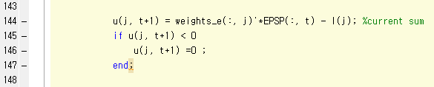
10x340 784x10 784x340 1x10
u(j, t+1) = weights_e(:, j)'*EPSP(:, t) - I(j)
1x1 784x1 -> 1x784 784x1 1x1
u(j, t+1) = weights_e(:, j)'*EPSP(:, t) ) - I(j)

Slide 3
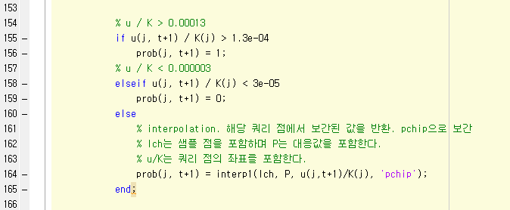

Slide 4
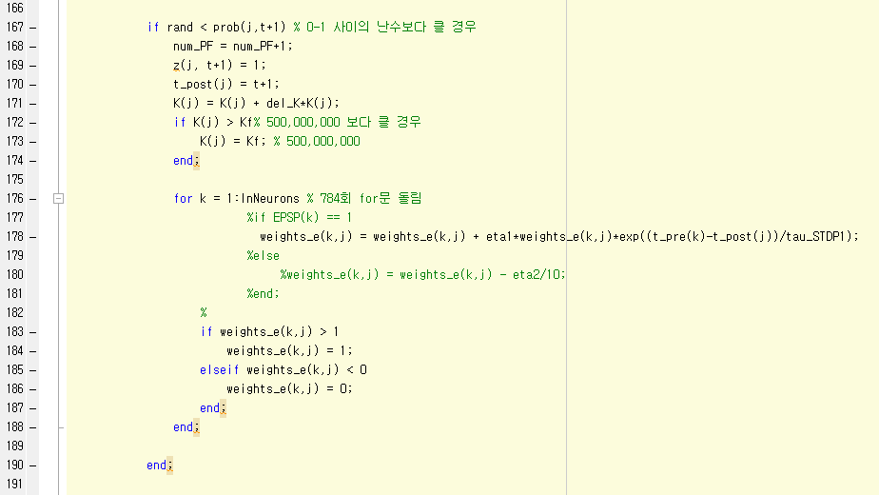


Slide 5
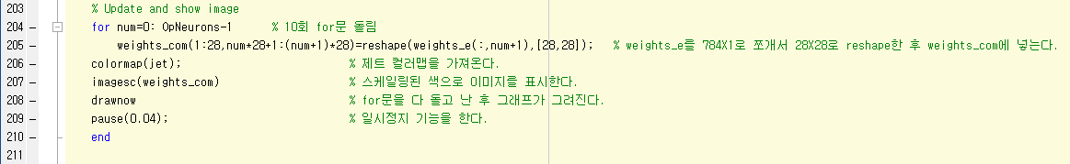

Slide 6
